Slide 1
Practical High Performance Computing
Dr. Chris Hill, Lauren Milechin,
Dr. Julie Mullen
January 21, 2025

Slide 2
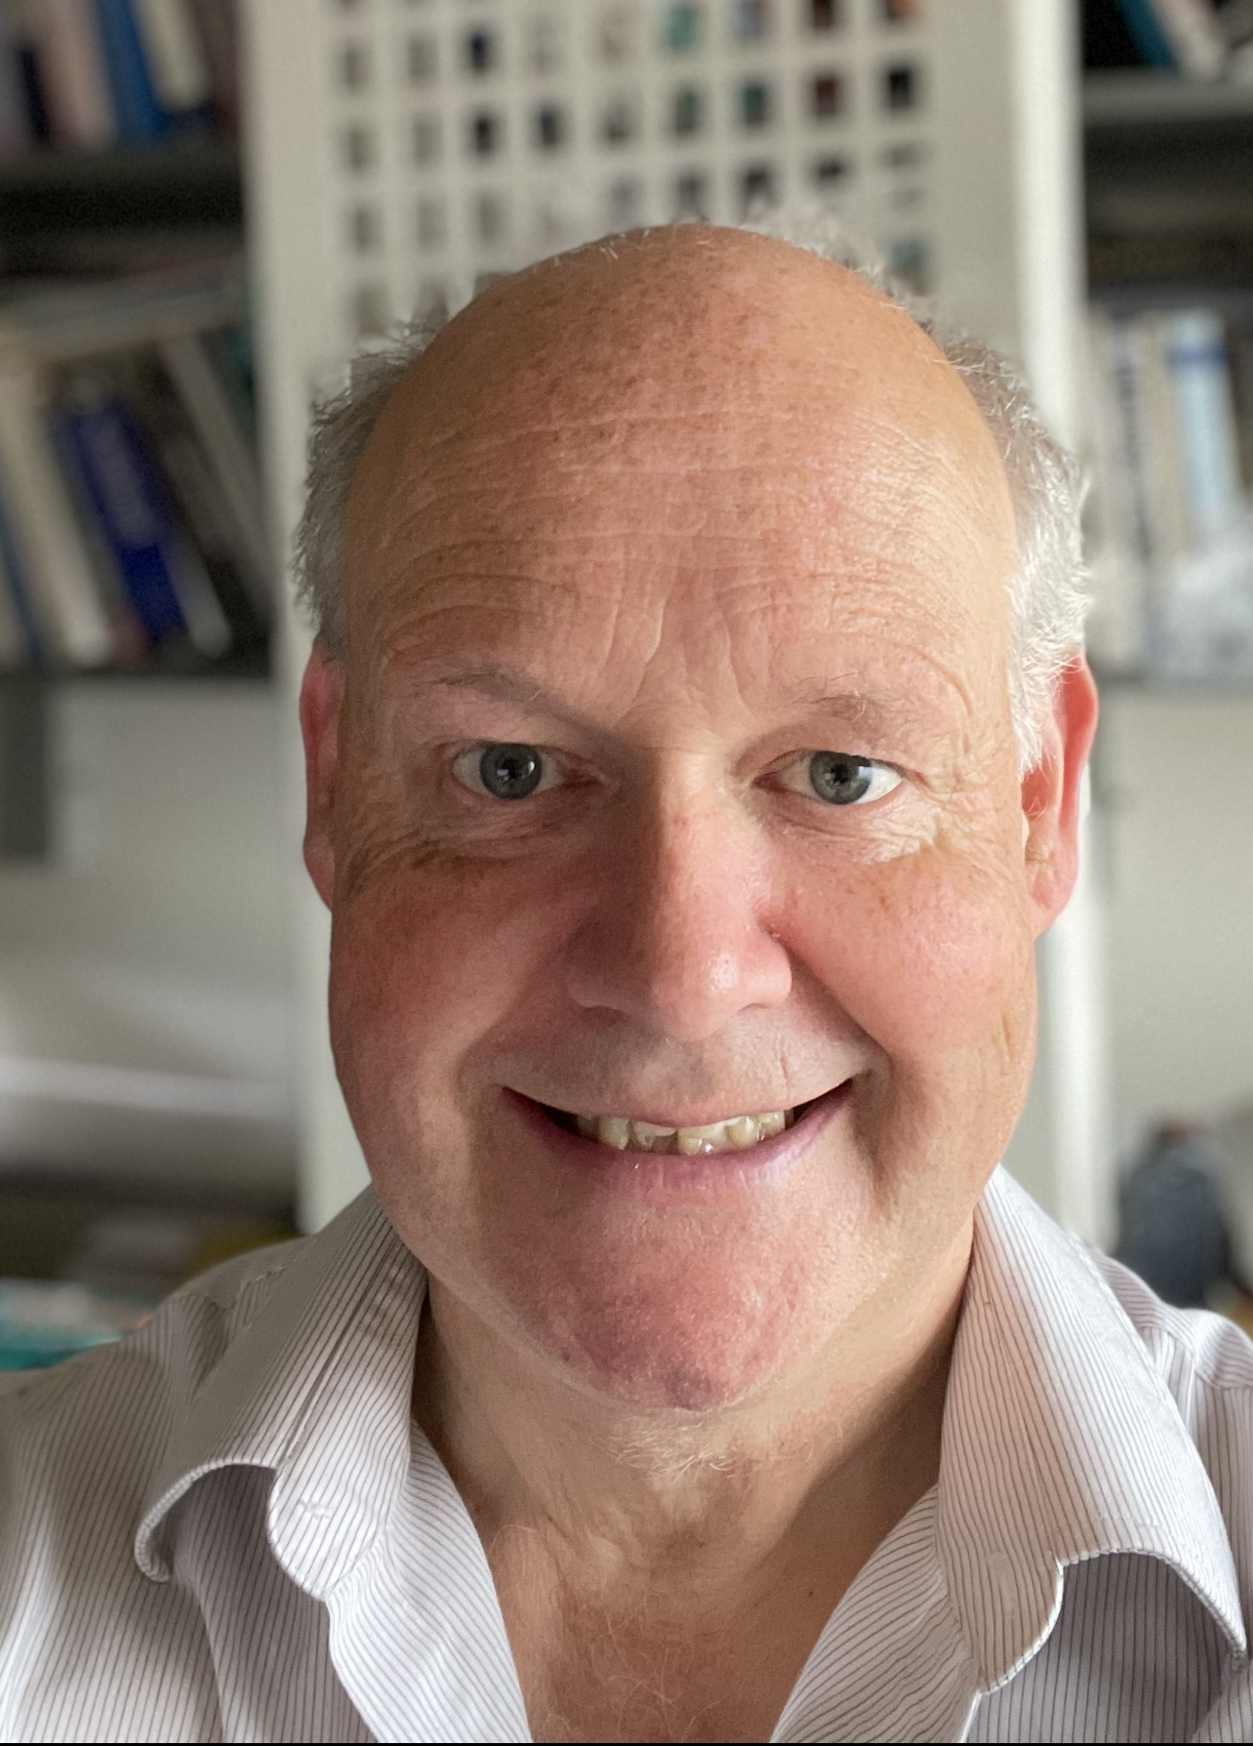
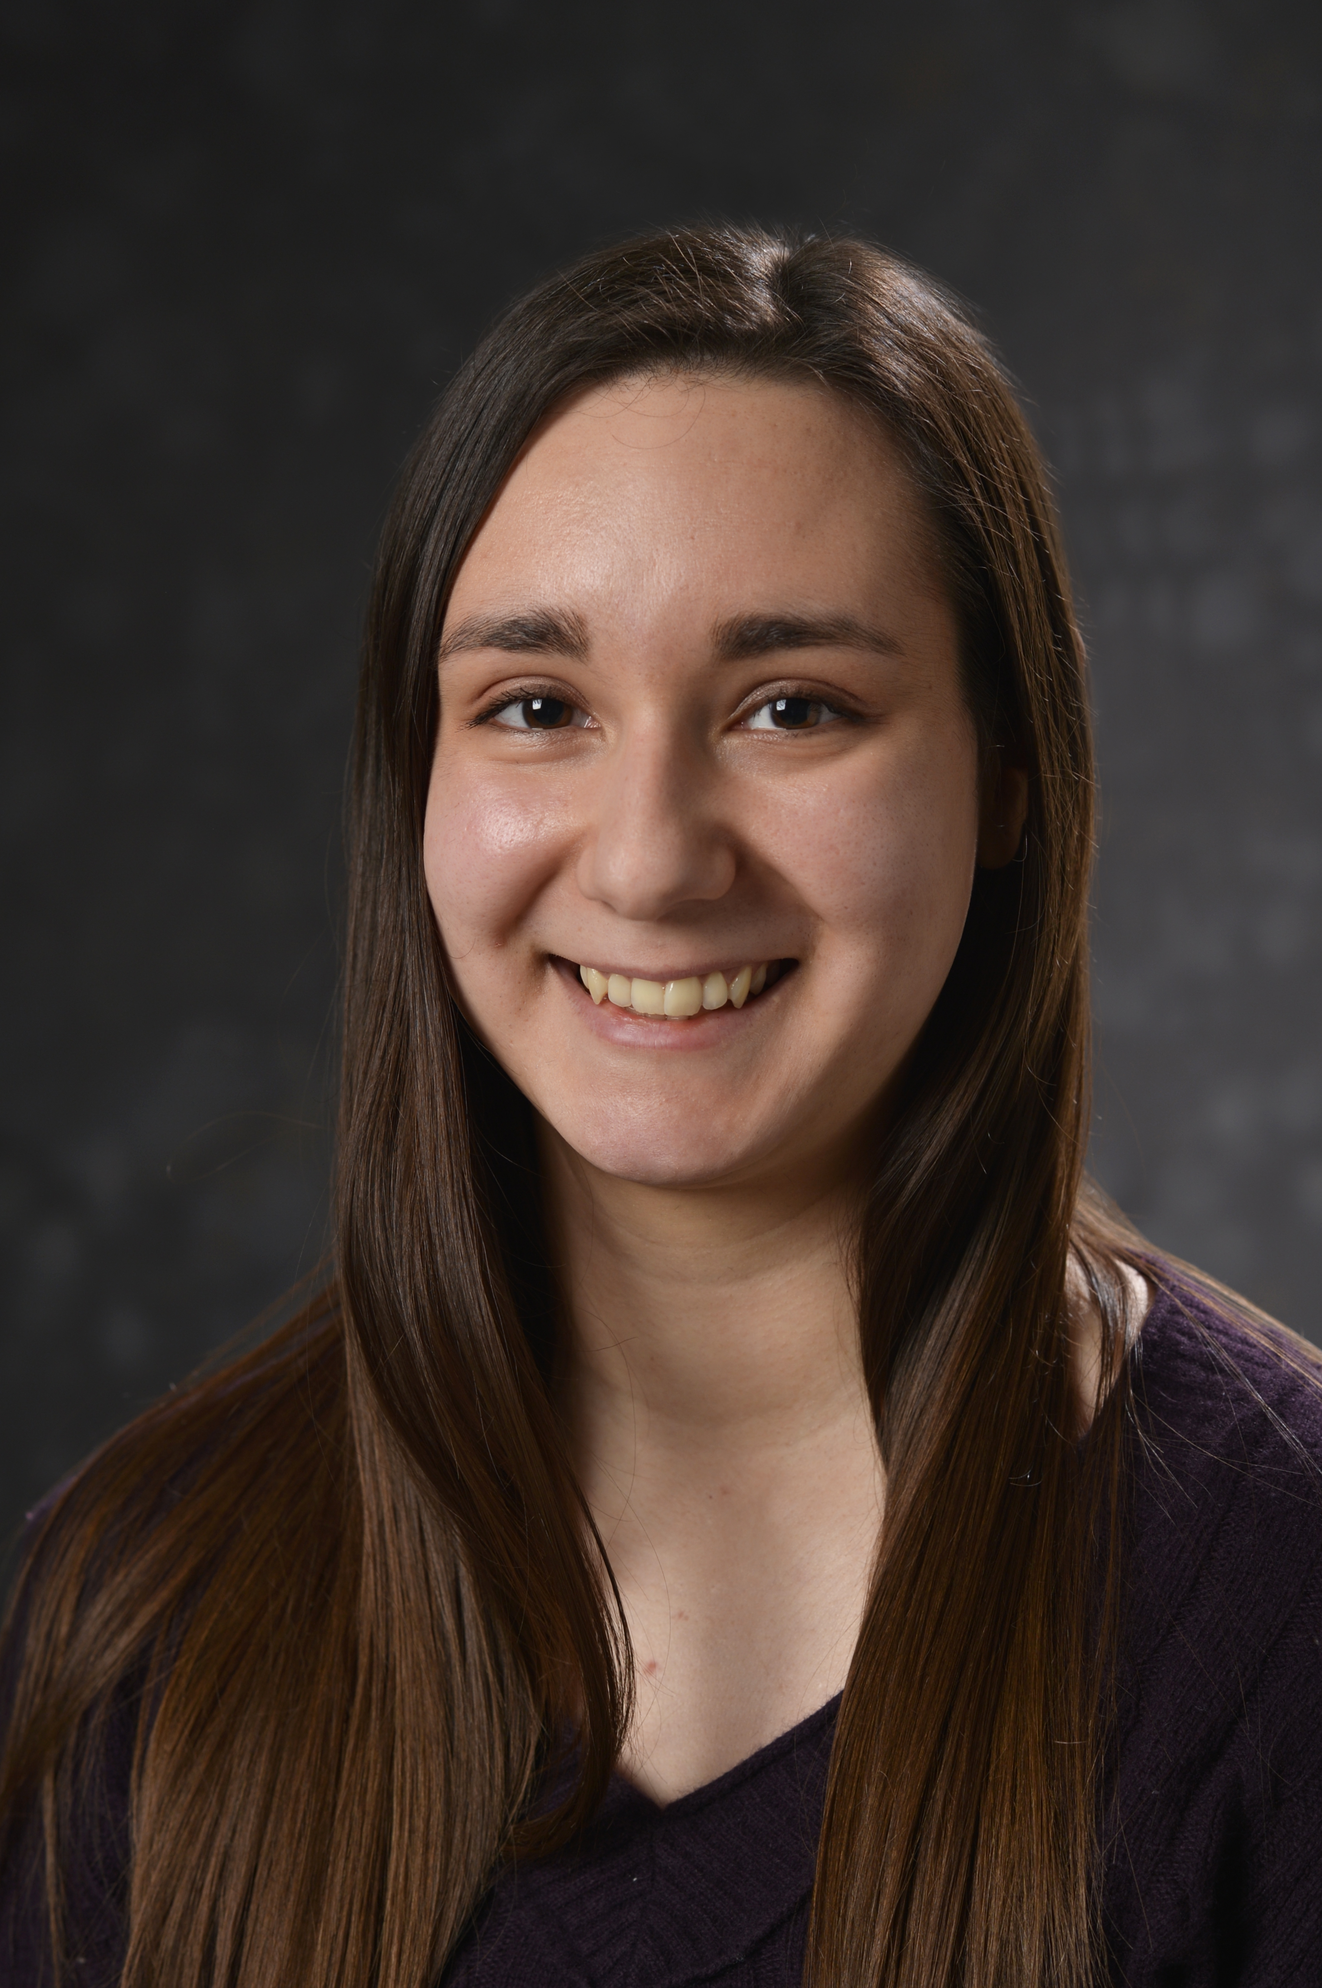
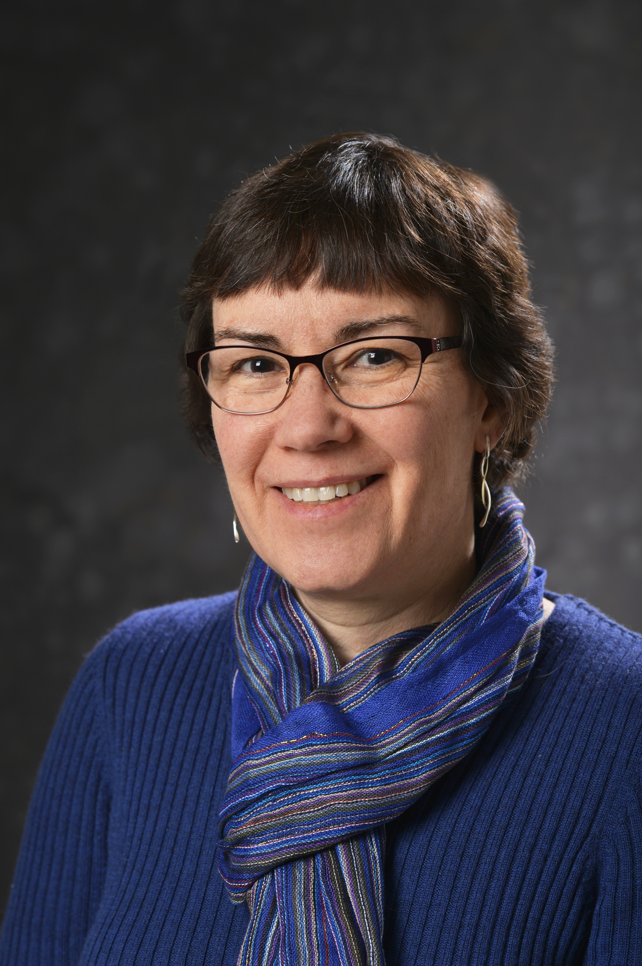

Who We Are
Dr. Chris Hill
Executive Director
MIT ORCD
Lauren Milechin,
Director of Scientific Consulting
MIT ORCD
Dr. Julie Mullen,
Technical Staff LLSC*,
MIT Lincoln Laboratory
Computational Engineer
*LLSC = Lincoln Laboratory Supercomputing Center

Slide 3
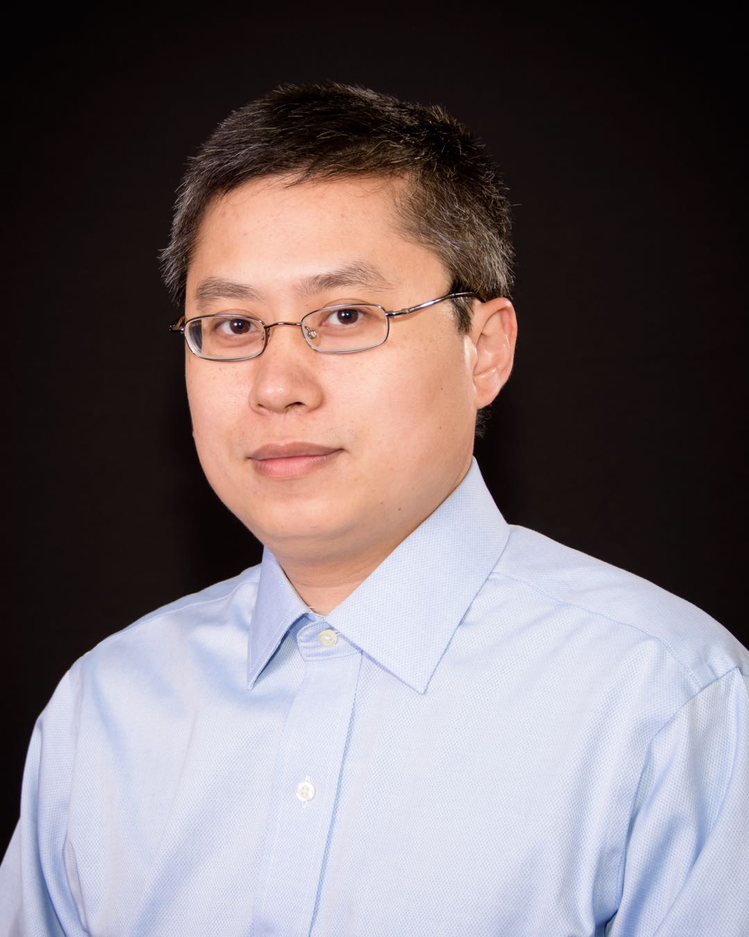


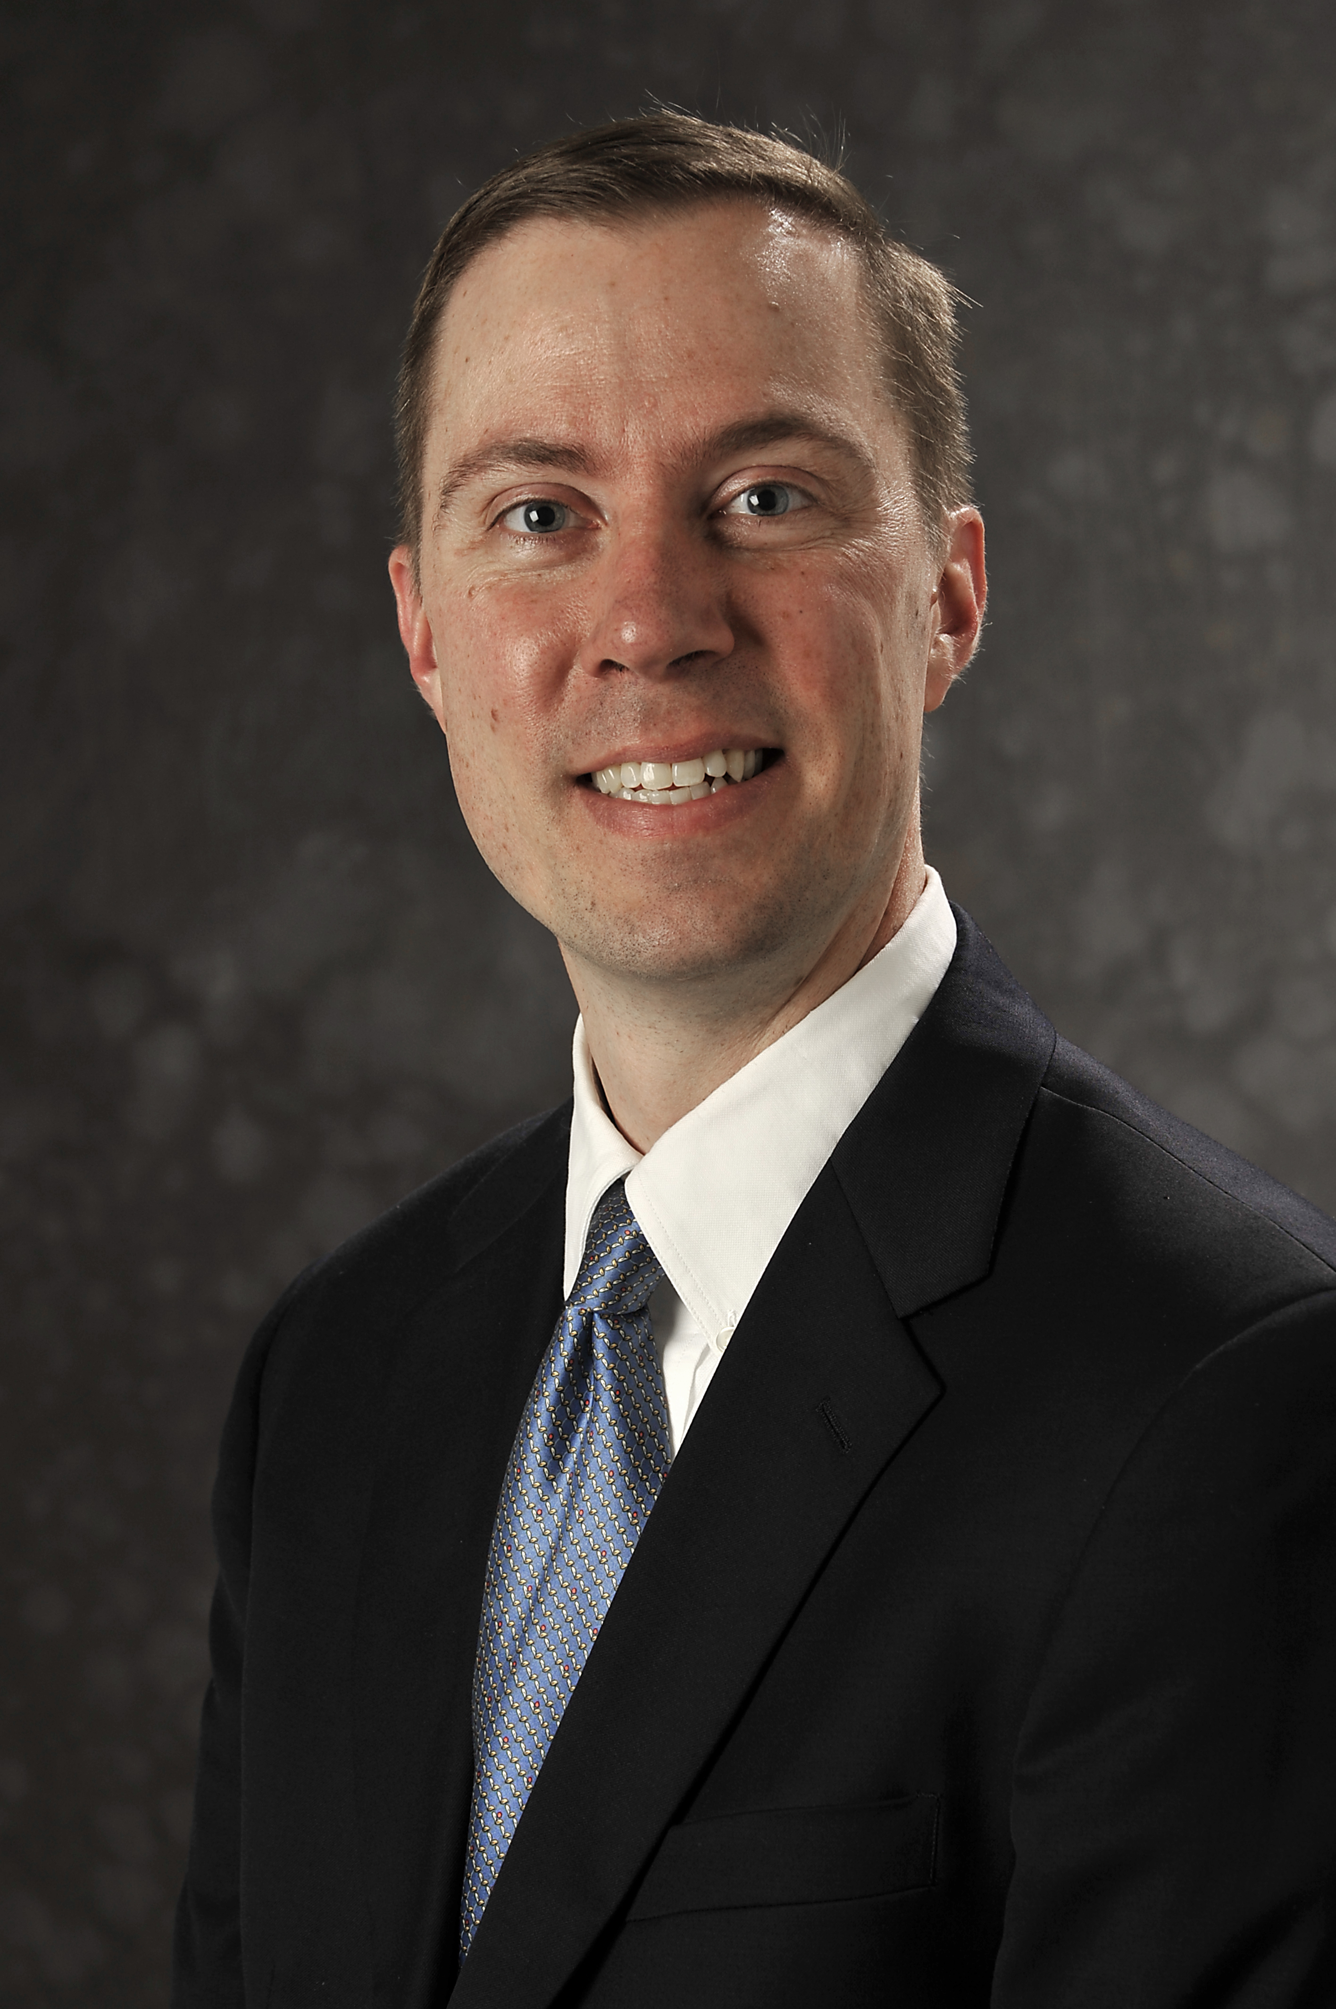
Guest Instructors and Helpers
Dr. Shaohao Chen
Computational
Support Specialist
MIT ORCD
Sam Corey
Computational
Support Specialist
MIT ORCD
Jonathan Murray
Computational
Support Specialist
MIT ORCD
Dr. Albert Reuther,
Senior Staff LLSC,
MIT Lincoln Laboratory
Computer Architect and Computational Engineer

Slide 4

Thank you!

Slide 5
What You Will Learn
At the end of this course you will
Know what HPC is and why and when you might want to use it
Understand how a supercomputer differs from a personal computer
What components are the same?
What components are different or new?
Understand how these differences affect application code
Know the common HPC workflows and how to
Map an application to a workflow
Efficiently implement the workflow on a parallel and distributed system
Have experience running applications using the canonical HPC programming models

Slide 6
Overall Schedule
All class sessions are in 45-804 from 2 - 5pm
Date | Activity
1/21/2025 | Introduction to Supercomputing Workflows and Systems
1/23/2025 | Serial Optimization and Parallel Speedup
1/28/2025 | Building and Running Parallel Workflows
1/30/2025 | Distributed Computing

Slide 7
Schedule Tuesday January 21, 2025
Time | Activity | Leaders
2:00 – 2:15 | Welcome & Class Overview | Lauren Milechin & Julie Mullen
2:15 – 2:30 | Introductions | Lauren Milechin & Julie Mullen
2:30 – 2:45 | Q & A for Asynchronous Material | Lauren Milechin & Julie Mullen
2:45 – 3:15 | Puzzle Lab | Lauren Milechin & Julie Mullen
3:15 – 3:30 | Break
3:30 – 4:00 | Introduction to Workflows - 1 | Lauren Milechin
4:00 – 5:00 | In-Class Project Work General Q & A | Lauren Milechin, Julie Mullen, Chris Hill, ORCD Team

Slide 8
Introduce Yourself
Name
Department
Undergraduate/Graduate Student? Staff?
1-2 sentence summary of your project
Goal for the class
What is your background
Programming
Parallel computing
Will you
Write your own code?
Use an existing code or package without modification?
Write scripts to create a workflow of packages or codes?

Slide 9
Asynchronous Material Q&A

Slide 10
Puzzle Lab

Slide 11
Before We Start
How do you define “Shared Memory Computing”?
How do you define “Distributed Memory Computing”?
Think about how the differences might affect a software application

Slide 12
Puzzle Metrics
Number of Workers | Shared (time in mins)
1 | 7
2
4
8
16

Slide 13
Shared Memory Discussion Questions
Think about the number of people in your group
How would fewer people have impacted your task and progress?
How would more people have impacted your task and progress?
What worked really well?
What challenges did you face?
Did everyone have work to do?

Slide 14
Distribution Types
Block
Cyclic
Block – cyclic

Slide 15
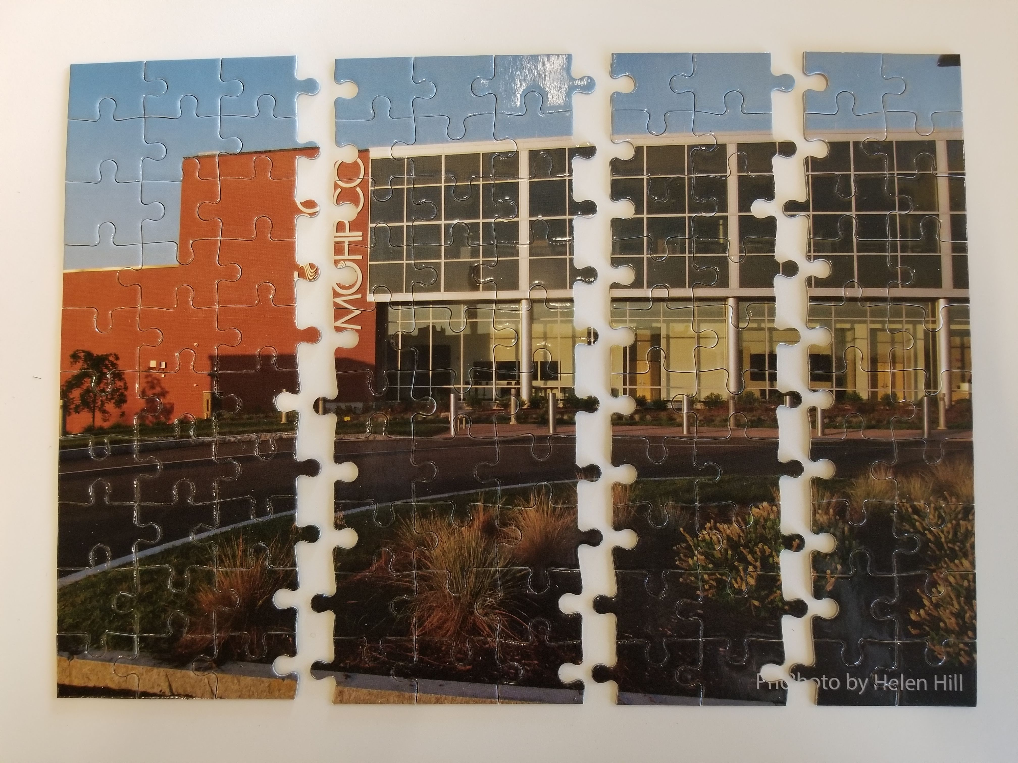
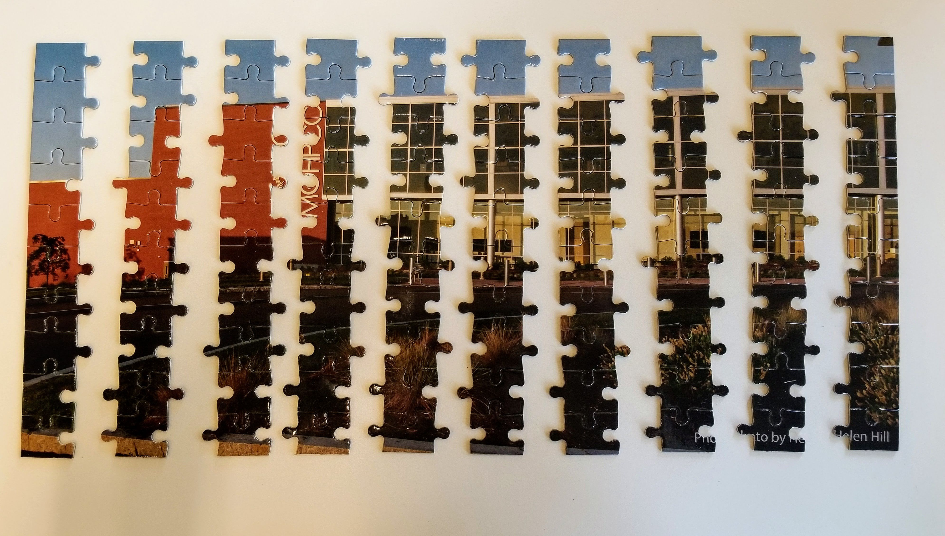
Distribution Types
0
1
2
3
0
1
2
3
0
1
2
3
0
1
Block
Cyclic

Slide 16
Puzzle Metrics
Number of Workers | Distributed (time in mins)
1 | 25
Block
Cyclic

Slide 17
Distributed Memory Discussion Questions
What challenges did you face?
What did you observe while working on the tasks?
How did it compare to the shared memory scenario?
How do you think the different memory paradigms impact the performance of the application?
What characteristics do you think would guide you in deciding which approach to take?

Slide 18
Break
Back in 15 mins

Slide 19
Introduction to HPC Workflows

Slide 20

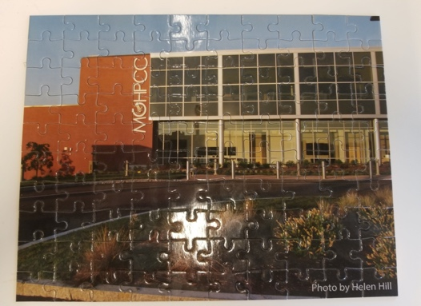
Workflows Review
Independent Tasks
Final Results
Independent Processing
Single Program Multiple Data
High Throughput Computing
Parallel Computing
Tasks
Intermediate
Final Result
Independent Processing
Reduction to single result
Loosely-Coupled Computing
Notes:
In summary, we can approach the varied supercomputing applications using a small number of canonical workflows. The Single Program Multiple Data or SPMD workflows, shown here as processes are:
High Throughput Computing
Loosely-Coupled Computing
Parallel Computing

Slide 21
Problem 1: Word Count
You have several files of documents
Want a summary of what they contain:
What are the the top 5 words contained in each document?
Consider:
Where is the independence?
What data access patterns do you expect?
Where is the data coming from?
Where does it need to go?
Process
File
System
read
count
books
counts
Notes:
Before we take a closer look at how to scale machine learning applications, let’s go over a few examples. These are based on a word count problem. We have several documents stored in files and we’d like to get a summary of what they contain. To do that we want to get the top 5 words used in each document.
The two questions you want to ask yourself to identify an HPC workflow and figure out how to parallelize an application are: Where is the independence? And What data access patterns do you expect?
In this problem we have one main operation: counting words. This operation can be done independently for each document. As far as data access goes, each file is read from the filesystem, counted, and then perhaps the result is written back to the filesystem. Since this entire process is independent…

Slide 22
Problem 1: Word Count
You have several files of documents
Want a summary of what they contain:
What are the the top 5 words contained in each document?
Consider:
Process 1
read
count
write
Where is the independence?
What data access patterns do you expect?
Where is the data coming from?
Where does it need to go?
File
System
Process 2
File
System
read
count
write
Process 3
read
count
write
Notes:
this is a throughput application and can be split up completely.

Slide 23
Problem 2: Overall Word Count
You have several files of documents
Want a summary of what they contain:
What are the the top 5 words contained in each document?
What are the top 5 words in all documents?
Consider:
Where is the independence?
What data access patterns do you expect?
Where is the data coming from?
Where does it need to go?
Process
File
System
read
count
merge
books
counts
overall
counts
Notes:
Now what if we wanted to get the top 5 words across documents? The initial word count step is still independent, but summing the counts from each book is not and has to be done in serial. For that to happen, the data from each process in the count step has to go to the process doing the merge. This is…

Slide 24
Problem 2: Overall Word Count
You have several files of documents
Want a summary of what they contain:
What are the the top 5 words contained in each document?
What are the top 5 words in all documents?
Map Step
Process 1
Consider:
read
count
write
Reduce Step
Where is the independence?
What data access patterns do you expect?
Process 1
Process 2
read
File
System
read
count
write
File
System
sum
Process 3
read
count
write
Notes:
A map reduce application, where the map step is the same as the throughput application we had before, and the reduce step involves summing the counts from each document.

Slide 25
Problem 3: Normalized Word Count
You have several files of documents
Want a summary of what they contain:
What are the the top 5 words contained in each document?
What are the top 5 words in all documents?
What are the normalized word counts for each document?
Consider:
Where is the independence?
What data access patterns do you expect?
Process
File
System
read
count
merge
norm
books
counts
overall
counts
normalized
counts
Notes:
Finally, let’s take it a step farther. We want to know which words are unique for each book by dividing the count for each book by the overall word count, we’ll call this the normalized word count. We could do this as a map reduce application like we did before, but there is an additional step at the end that is independent, assuming each process has the overall counts. This is…

Slide 26
Problem 3: Normalized Word Count
You have several files of documents
Want a summary of what they contain:
What are the the top 5 words contained in each document?
What are the top 5 words in all documents?
What are the normalized word counts for each document?
send to P1
send to P2, P3
Process 1
read
write
d1
count
c1
c3
sum
c
c1
norm
n1
Process 2
write
File
System
read
c
c2
norm
n2
File
System
d2
count
c2
Process 3
norm
write
read
c
c3
n3
d3
count
c3
Notes:
A parallel application. Each process can count the words in its book and send their counts to process 1 who does the merge. Process 1 then sends the overall counts to process 2 and 3, who can then produce the normalized counts and write out the result.

Slide 27
Common HPC Workflows
High Throughput Computing
Fully Independent Computations
Fire and Forget
Map Reduce
(Loosely Coupled)
Single data gather step
Bulk Synchronous
(Task Parallel)
Multiple languages, varying resource needs at every step
Increased Coupling
Increased Independence
Increased Speedup
Shared Memory Parallel
Intermediate results shared among worker processors on same machine
Distributed Memory Parallel
Intermediate results shared among worker processors across multiple machines
Notes:
When we look at scaling up an application, we’ll often categorize it into one of these common High Performance Computing, or HPC, workflows. The workflow that goes with your application depends on the structure of your code and how it can be broken up to run components in parallel, but also the hardware you have available. In general, the workflow that goes with your application will determine how easily you can scale. Often different libraries and software provide solutions for different workflows
The first of these is High Throughput. High throughput applications are those which have fully independent computations. Thinking programmatically, this would often look like code that could be written as one big for loop where each iteration is not dependent on the one before. You can scale by running multiple iterations at the same time in parallel. In a throughput application you can usually get the most speedup, or take the most advantage of additional hardware. This is because each process does not need to communicate with any other and there is little to no redundant operations done by each process. If you’ve heard the term “embarrassingly parallel”, or as we like to say “pleasantly parallel”, this is referring to high throughput.
Map Reduce applications build on throughput. It refers to the process of ”mapping” an operation on a number of inputs, and then performing a single operation on the output of each input to produce one result (the reduce step). The Map step can be broken up just like a throughput application. The reduce step is done by a single process, and can either be done by one of the map processes after the map step is complete, or by an entirely new process that starts up after.
The first two workflows are called data parallel- you are running the same operation (or task) on a number of different inputs, or data. The next workflow refers to task parallel applications. In this case we are potentially running discrete tasks simultaneously, sometimes in multiple languages, with varying resource needs at each step. These applications tend to be fairly complicated and often require more work to get running.
Finally we get to the fully parallel models. When applications cannot run fully independent, we call them parallel. These applications involve some amount of communication between processes, which takes time and can decrease the amount of speedup you can get. We can categorize these into two workflows: shared memory and distributed memory.
Shared memory parallel is where every process is on the same computer. In this case communication happens using the memory space on that computer, hence the name “shared memory”. If you’ve heard of multithreading, that is a shared memory model. Shared memory applications are limited by the memory and number of cores available on a single computer.
In a distributed memory application each process can run on a different computer, which is why it is called “distributed”. Since computers can’t see into the memory of other computers, when the processes have to communicate they do so over a network connecting the machines together. HPC Clusters, or Supercomputers, have been optimized for this type of application have have very fast interconnect between nodes, or computers. Distributed applications are limited by the scalability of the application.

Slide 28
Projects

Slide 29

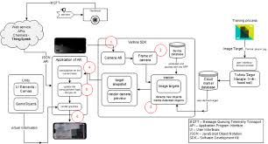


Approach to Scaling Up
Starting point
Develop &
Validate Model
Test Serial Code
on Linux System
Scale Code to Multiple Cores
Post-Process Results
Explore Models
Condition Data
Explore data sets using graphing tools
Prepare for ML models
Develop algorithm or model
Test and Validate algorithm or model
Transfer data to system for testing
Transfer code to system for testing
Establish environment consistent with development environment
Run validated model on single core and verify results
Matlab
Python
C/C++
Explore methods of scaling
Linux
Scheduler commands
Develop distributed or High Throughput version of algorithm or model
Run algorithm at scale – production runs are batch submissions
Transfer data to local machine
Plot results
Matlab
Python
Analyze results to determine next steps
Application workflow running on desktop
Data sets or files
Local Machine
Supercomputer

Slide 30
Projects
Pick an existing application and work towards scaling it up
Milestones:
Day 1: Run in serial on Engaging, SuperCloud, or other ORCD system. Identify your workflow.
Day 2: Time and evaluate your serial code, determine what resources you need.
Day 3: Come up with a plan for scaling up. Run your application as a job through the scheduler. Start working on scaling up.
Day 4: Continue working on scaling up. Present on your work so far. Write a report on your project.

